Slide 1






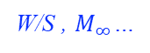

Why Focus on Conceptual-Stage Optimization?
Reason 1: >80% of the performance of the final design is determined by early-stage design decisions
Example: Transport Aircraft Fuel Burn
Pratt’s, GE’s design domain
Most design opportunities can’t be captured later
Passenger loading: one of many disciplines not typically considered during conceptual design
FPR,
^{T}t 4
.
.
.
common apparent (false) optimum
existing engines
B737-800
Mach: 0.80
L/D: 15.2
MTOW: 166k lb.
Field: 8000 ft.
D8.1/8.1b
Mach: 0.72
L/D: 19.5 – 22.0
MTOW: 120 – 130k lb.
Field: 5000 ft.
true optimum
Boeing’s, Airbus’s design domain
Same requirements & tech. assumptions,
$≈−49\%$ fuel burn
fuel economy isocontours
existing airplanes
W/S , $M_{∞}$…
Both figures adapted from Drela, “Simultaneous Optimization of the Airframe, Powerplant, and Operation of Transport Aircraft”. RAeS Conf., 2010

Slide 2
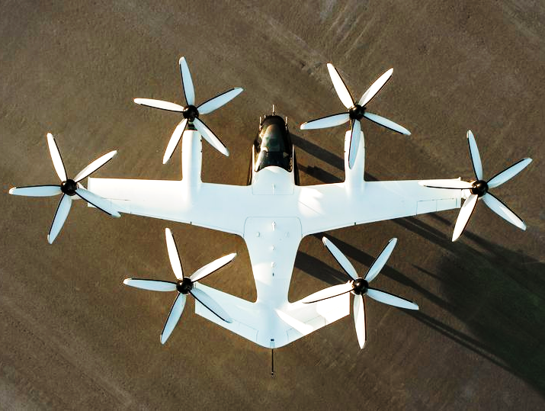
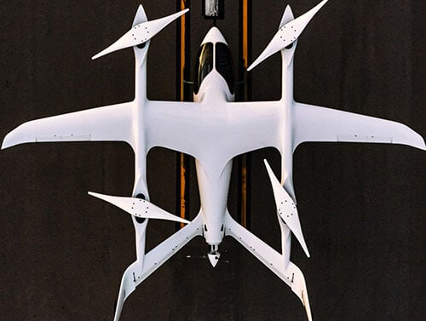
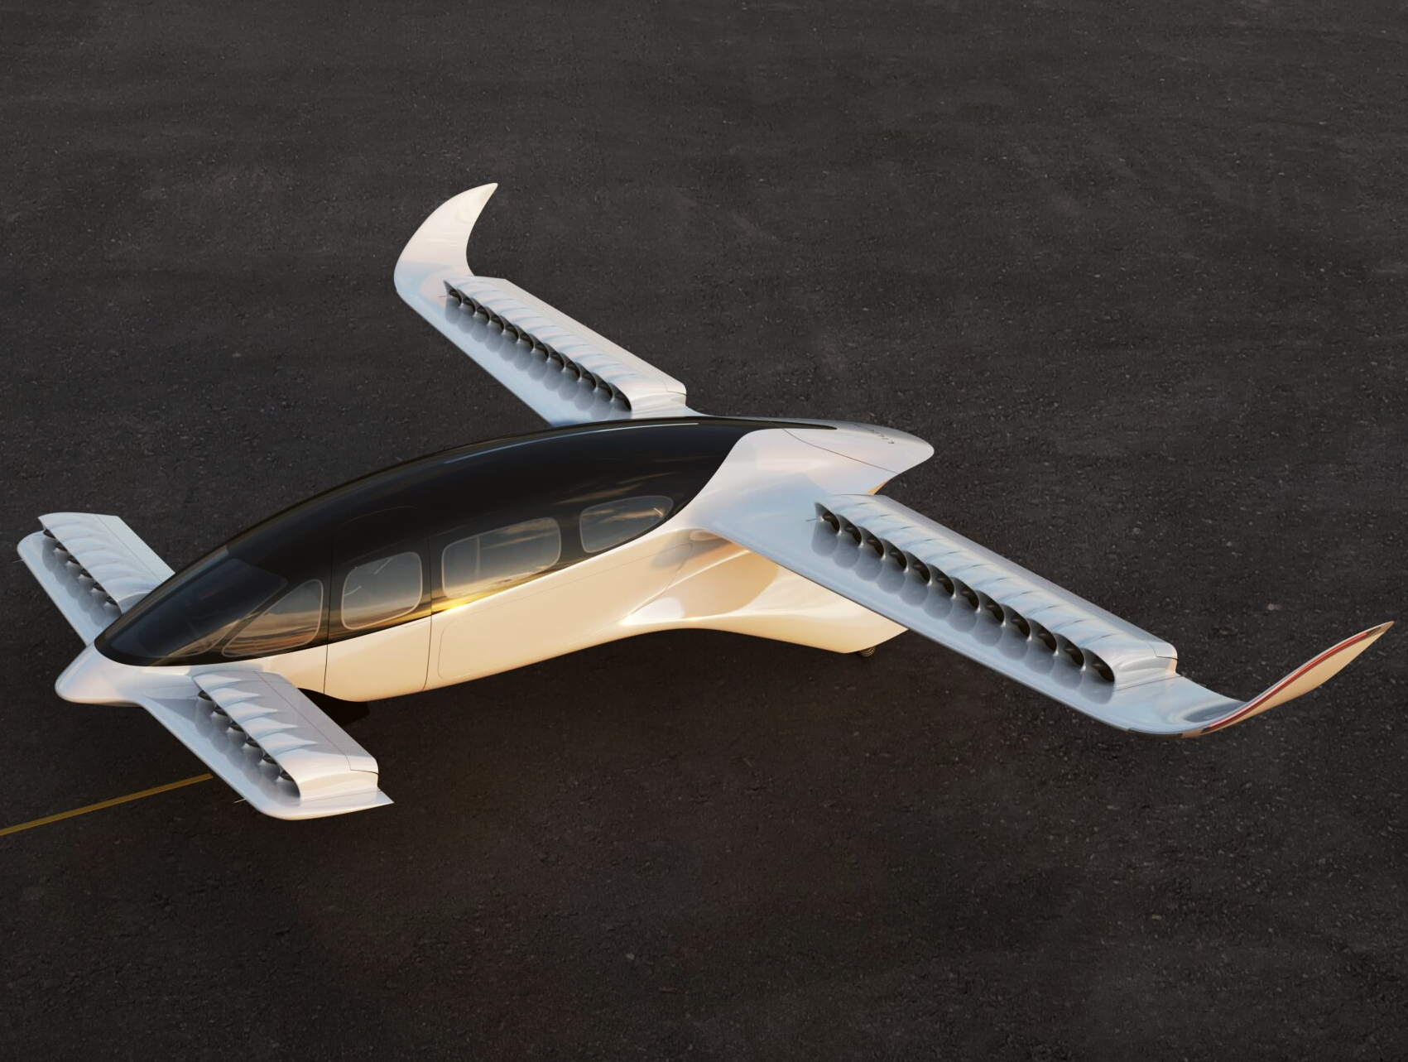
Why Focus on Conceptual-Stage Optimization?
Reason 1: >80% of the performance of the final design is determined by early-stage design decisions
Example: eVTOL Noise
“The very next design principle, behind safety, was noise.”
-Joby Aviation, on conceptual design SEC 001-39524: “Virtual Fireside Chat with Joby…”
Most design regrets can’t be fixed later
Noise: one of many disciplines not typically considered during conceptual design
Joby Aviation S4
BETA Alia-250
Lilium Jet
All images reproduced from their respective manufacturers
Less noise
More noise
[1] SEC 001-39524: “Virtual Fireside with Joby”…
Notes:
For low noise, there are certain design choices that you want, from first-principles:
Low tip speed
High solidity
Low disk loading
(ideally) odd number of blades
For example: Beta DOES NOT HAVE THE OPTION of going to a 3-blade configuration, since their concept relies on blade locking in a low-drag configuration for cruise – no amount of blade shape optimization will change that fundamental limit.
https://www.sec.gov/Archives/edgar/data/1819848/000119312521092808/d59889d425.htm
Conceptual Design of the Joby S2 Electric VTOL PAV
https://www.jobyaviation.com/S2ConceptualDesign(AIAA).pdf

Slide 3
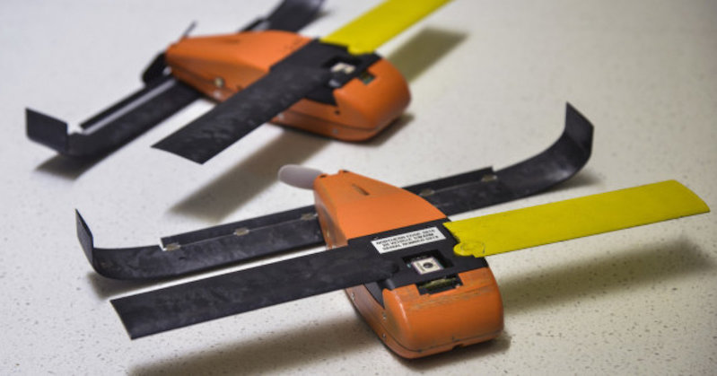
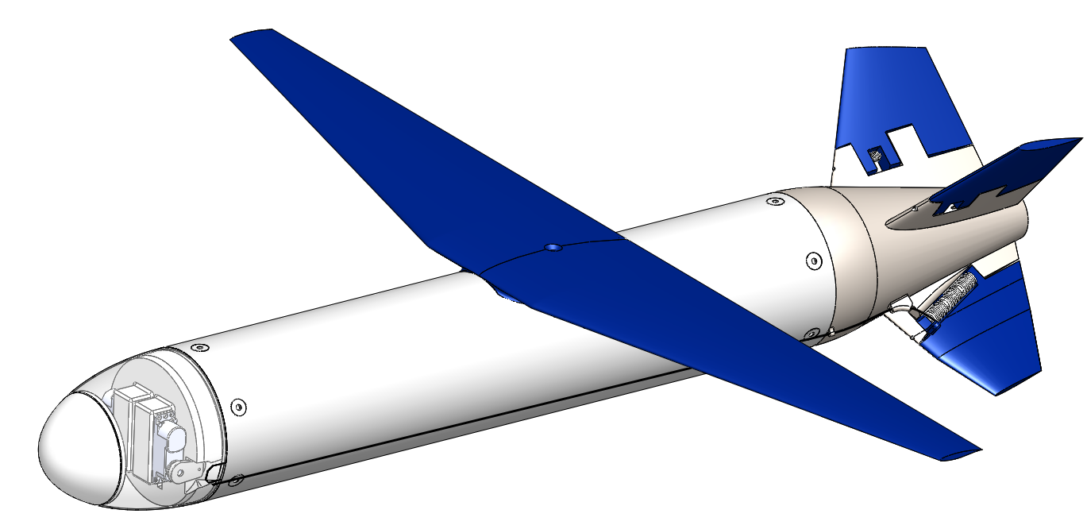

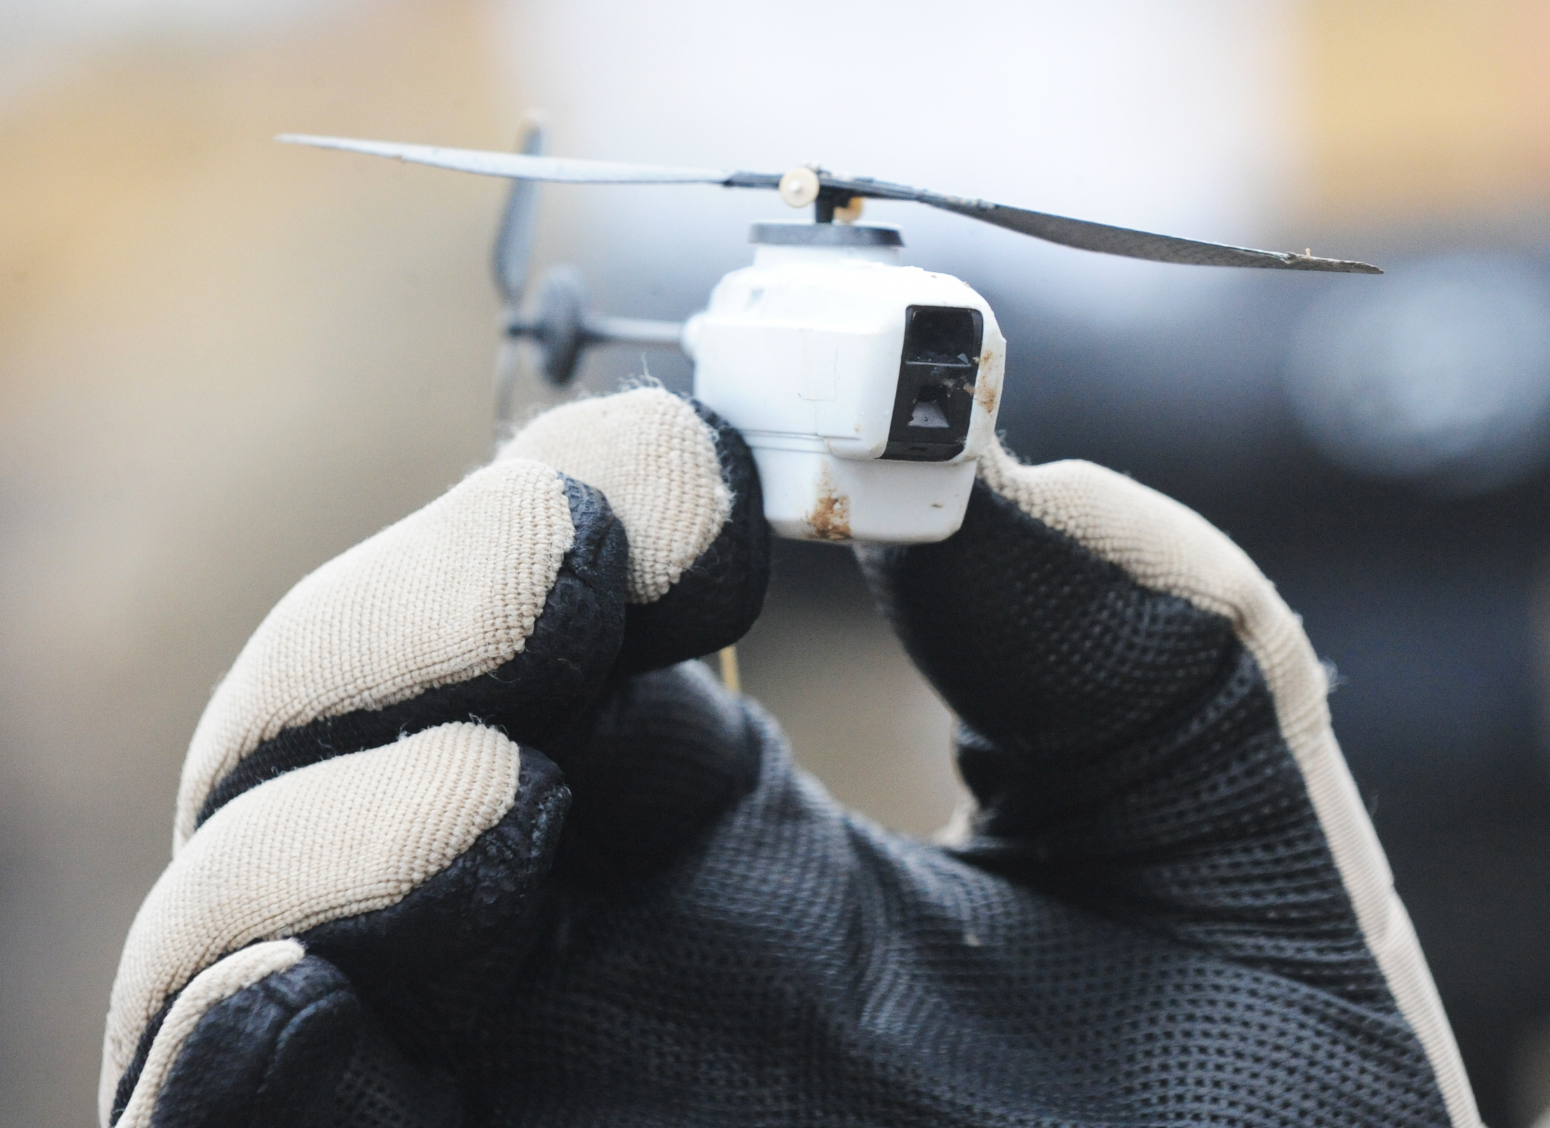

Why Focus on Conceptual-Stage Optimization?
Reason 2: These days, new technologies are enabling more early-stage aircraft design space exploration than ever before
Example: Drones / UAVs
Able to take more risks with exotic designs:
Shorter design cycles, lower cost
Minimal certification and safety risks
New trade spaces to explore
Packaging/folding – every ${mm}^{3}$ counts!
Autonomy & computing SWaP
Payload miniaturization
New missions: dull, dirty, and dangerous
Attritable design and cost optimization
Physics: scaling laws
Square-cube
Reynolds numbers
MIT Firefly (Mach 0.8, rocket-propelled micro-UAV)
MIT Perdix (Air-launched ALE-55-class ISR UAV)
Transonic DP 545 mph dynamic-soaring glider 100 G sustained turn capability (Photo: Spencer Lisenby)
Black Hornet Nano 18-gram ISR helicopter (Photo: Richard Watt/MOD)

Slide 4
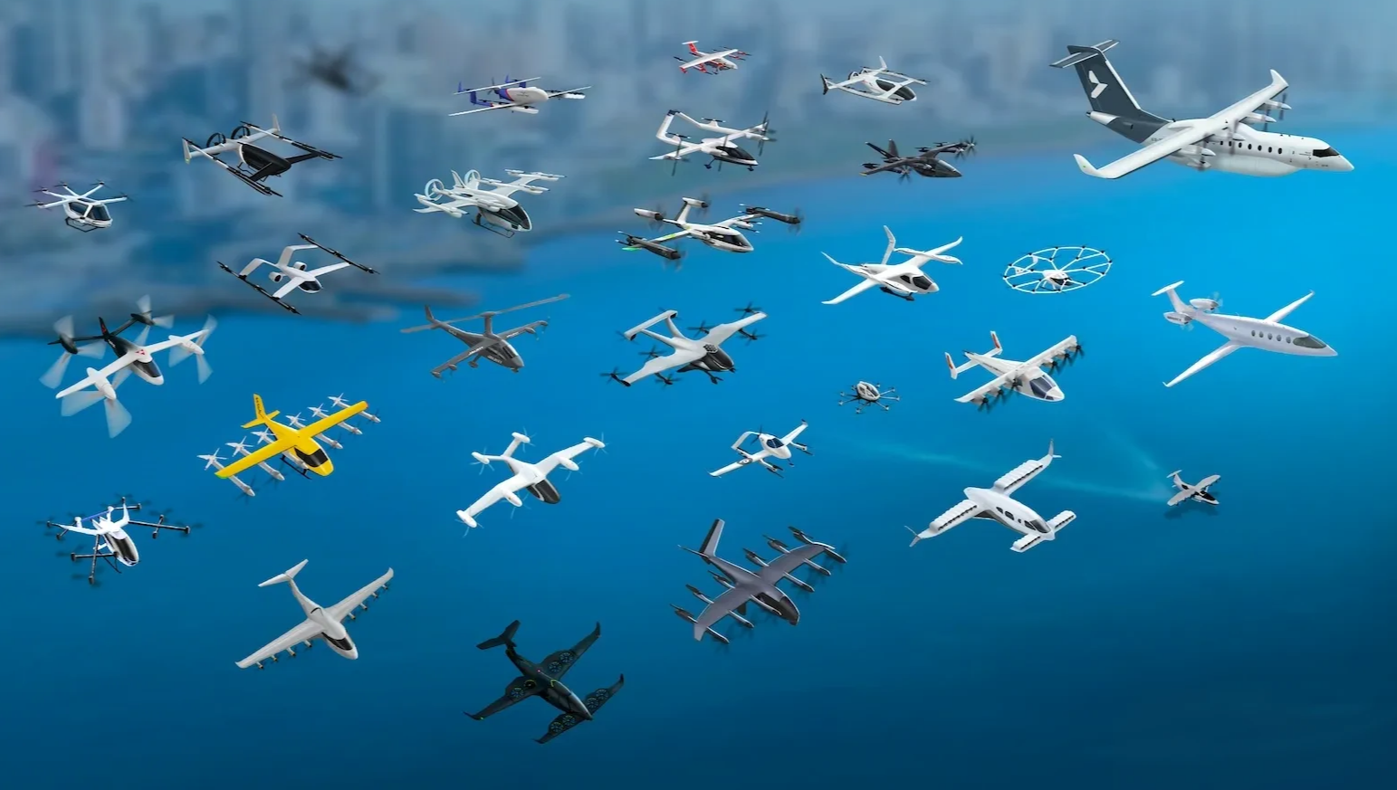
Why Focus on Conceptual-Stage Optimization?
Reason 2: These days, new technologies are enabling more early-stage aircraft design space exploration than ever before
Example: Urban Air Mobility / eVTOLs
Figure adapted from SMG Consulting, “AAM Reality Index”
After a decade, still no clear consensus on the “right” way to use electric propulsion.
Electric propulsion is fundamentally different:
 | Conventional | Electric
Energy Storage | Kerosene | Batteries
Energy Transmission | Combustion engines | Electric motors

Slide 5
Why Focus on Conceptual-Stage Optimization?
Reason 3: The true value of conceptual MDO isn’t only in answering questions (“the point design”) – it’s in determining which questions we should be asking
Requirements Feedback
Which requirements are driving, and which are unimportant?
How should we negotiate requirements?
Where can we give margin, and where do we need margin?
Market Identification & Competitive Analysis
Given our technologies and capabilities, which customers should we be pitching to?
Where are the market gaps in competitor offerings?
Risk Reduction
How much margin do we have to various constraints?
Which key model assumptions are we sensitive to?
What’s the most cost-effective way to reduce uncertainty in our ability to deliver?

